Slide 1

User Distribution Analysis
Duolingo Language Learning App
Presented by Fiona Pang

Slide 2
Introduction
Duolingo is a language learning app that serves global users.
Users came from different countries with different backgrounds and aimed to learn a second language.
Insights and improvement based on user distribution
https://runze.github.io/technical-posts/an-analysis-of-foreign-language-learning-using-duolingo-data/

Slide 3
Agenda
Introduction
Data Exploration
Analysis and Finding
Conclusion

Slide 4
Introduction
Duolinguo – free, award-winning language learning online platform
Over 150 million users over the world since it launched in 2012

Slide 5
Introduction
Data set – the 13 million users learning traces
What insights and potential improvement of sales from user trances?
https://github.com/duolingo/halflife-regression

Slide 6
Data Exploration
P_call – proportion of exercises from lession where vocabulary was correctly recalled
Timestamp – UNIX teimstamp of current lesson
Delta – time in second since the lase lesson
Learning_language – language being learned
Ui_language – user interface language
History_seen – total times user has seen the volabulary prior to the lesion
Hisory_correct – total times user recall the vocabulary correctly
Seeesion_seen – times the user saw the wordduring the lesson
Session_correct – times the use got the vocabulary correct during this lesson

Slide 7
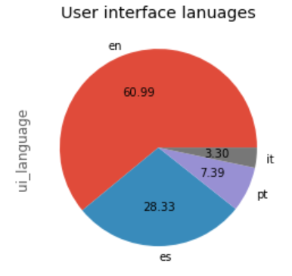
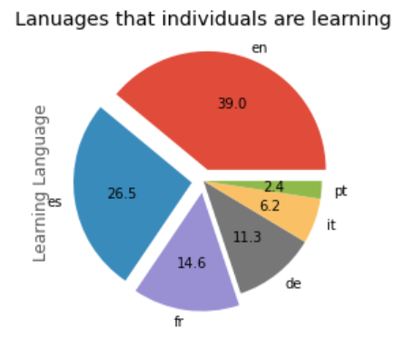
EDA & Analysis
Learning_language – language being learned
Ui_language – user interface language
En – English
Or – Portugues
Es – Spanish
It - Italian

Slide 8
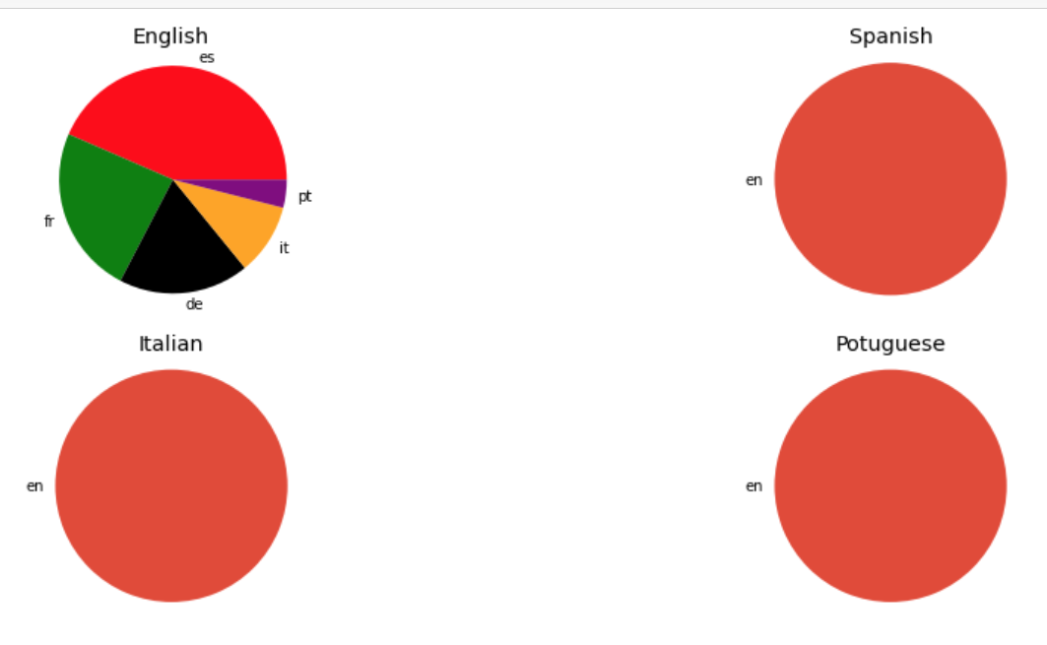
EDA & Analysis
What languages being learned by people whose interface languages are English, Spanish, Italian and Portuguese by subplot four pies plots

Slide 9
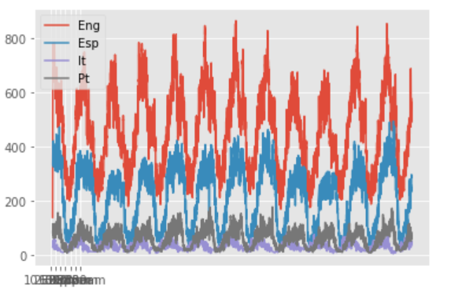
EDA & Analysis
Visualize each interface language users daily activity pattern onto a single plot

Slide 10
Summary & Conclusion
Users mainly come from English and Spanish-speaking countries
Users whose native language is French, Portuguese, Italian and German are only interested in learning English
Users whose native language is English spent more time learning a new language, and users whose native language is Portuguese spent the least time on learning.
Diversify user background – attract users from Asia or who speak other minor languages.
Considering focusing on English learning.
More research needed / a strategy is needed to improve the learning time of users whose native language is Portuguese

Slide 11
Thank you

